Slide 1

POWERFUL
PLANNING!
A strategy for success
Notes:
To use this title animation slide with a new image simply 1) move the top semi-transparent shape to the side, 2) delete placeholder image,
3) click on the picture icon to add a new picture, 4) Move semi-transparent shape back to original position, 5) Update text on slide.

Slide 2
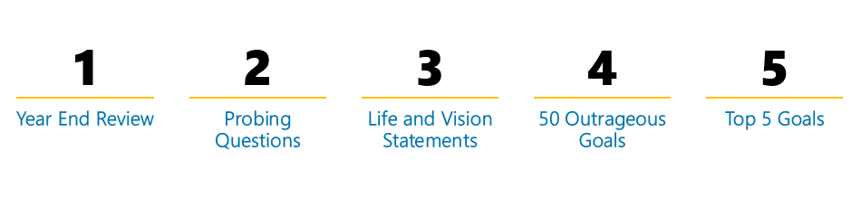

THE STAGE HAS BEEN SET
go ahead and follow the basic 7 steps below
What you document here can be used alone, but I highly recommend purchasing a high quality planner to create a timeline.
Reference : The basics you can find anywhere 5 Steps To Successful Storytelling Published on April 5, 2014 Featured in: Marketing & Advertising

Slide 3

1
“If you don’t know where you’ve come from, you can’t know where you’re going.”
-Maya Angelou
Review
    Get honest with yourself and celebrate your wins and losses from last year. Use the following pages as a guide.

Slide 6


2
“To Thine Own Self Be True”
-Shakespeare
DIG DEEP
    Who | What | Where | When | Why
    Use the questions on the next page to help you discover and/or review your true desires.

Slide 7
STAY TRUE
The only way to enjoy your success is the make sure it lines up with who you really are deep inside. Take the time to get to the bottom of these questions by asking yourself “why?”at least 3 times before moving on.
“What would I want to experience in this lifetime if time and money were not an issue?”
“What kind of Growth do I want to experience?”
“What do I want to Contribute to the World”

Slide 8
LEGACY
Don’t let your experience in this lifetime slip by without deciding what gifts you’d like to leave behind.
“If I achieved all of my life goals, how would I feel? How can I feel that way throughout the process?”
“How do I want to be remembered when I’m gone?”
“Why am I here?”

Slide 9
HAPPINESS
Happiness is the most important thing to seek in this lifetime. The pursuit of that feeling is what motivates us to do all that we do.
“What do I value most in my life?”
“What brings me the most peace and joy in my life?”
“What does a successful life look like for me?”

Slide 10
CELEBRATE
Take some time to build your confidence in your ability to achieve by remembering your accomplishments and considering how you already add value to those around you.
“What do others most admire about me?”
What are my top 10 achievements in life?”

Slide 11

3
“Write the vision. Make it clear on tablets so that anyone can read it quickly”
-GOD (God’s word translation Habakkuk 2:2)
CREATE A MISSION/VISION STATMEMT
  Summarize your ideal mission (what you plan to acquire now in order to contribute tomorrow).
Notes:
Tip:
When using complex image as full-bleed background add a transparency (70%-90%) fill layer to give contrast to text.

Slide 12
  My mission is to…
  In order to carry out my vision of…
—MY BEST VERSION

Slide 13
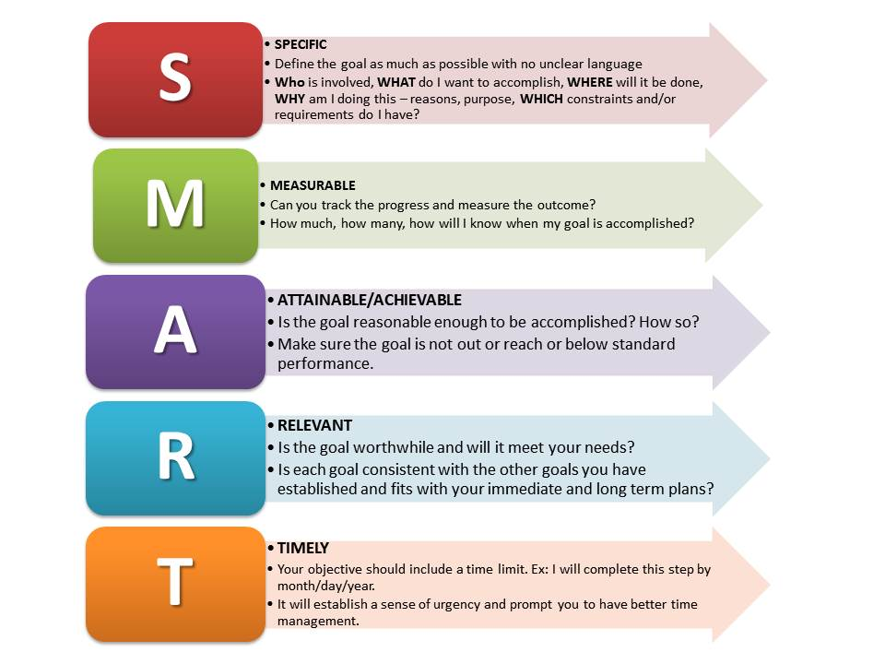
4
“A goal should scare you a little & excite you a LOT”
-Joe Vitale
CREATE 50 WILDLY EXCITING GOALS
  Although you want your goals to be a little out of reach, make them accessible by following the S.M.A.R.T. Guideline. Document them on the following pages.

Slide 14
5 Spiritual Goals
1
2
3
4
5

Slide 15
5 Personal Development Goals
1
2
3
4
5

Slide 16
5 Relationship Goals
1
2
3
4
5

Slide 17
5 Friendship Goals
1
2
3
4
5

Slide 18
5 Career/Business
1
2
3
4
5

Slide 19
5 Financial Goals
1
2
3
4
5

Slide 20
5 Health Goals
1
2
3
4
5

Slide 21
5 Family Goals
1
2
3
4
5

Slide 22
5 Leisure/Pleasure Goals
1
2
3
4
5

Slide 23
5 Miscellaneous Goals
1
2
3
4
5

Slide 24

5
Know the end
at the beginning
This Years Top 5 Goals
    From the 50 goals you created above, select the 5 that align most with your Life Mission and Vision Statement. Choose specific rewards, prepare for the mental blocks and distractions that are sure to come on the following page.

Slide 26

6
The Map
Summarize
    Use the next two pages to map out how your top 5 goals will help you get to where you want to be in all areas of life by the end of the year.

Slide 29
7
“Live the Story You Want to Tell”
-Simply Topaz
What’s the life story you want to live? Use this space to document it.
Notes:
Tip:
When using complex image as full-bleed background add a transparency (70%-90%) fill layer to give contrast to text.

Slide 30

TAKEAWAY
        Use what you’ve documented here as a compass. Review it as often as you think about it; at least quarterly.
INSPIRE
        Enjoy your newfound clarity and allow it to be a grounding force for you when life gets crazy.
ACTION
        Use the “5 Steps to achievement” section on page 26 to create 1 major goal and 3 sub-goals for each month at the BEGINNING of the year. Don’t wait to add them month by month. It’s ok to adjust throughout the year, but make sure you have a plan for the entire year laid out in advance. Write in pencil if you need to.
        You can fill in details that pop up as daily goals throughout the year. Live Well!
Notes:
Combine an image and multiple key statements with a strong grid.

